Slide 1
Stress Orientation Rotation of the 2018 Mw 7.5 Palu Earthquake

Slide 2
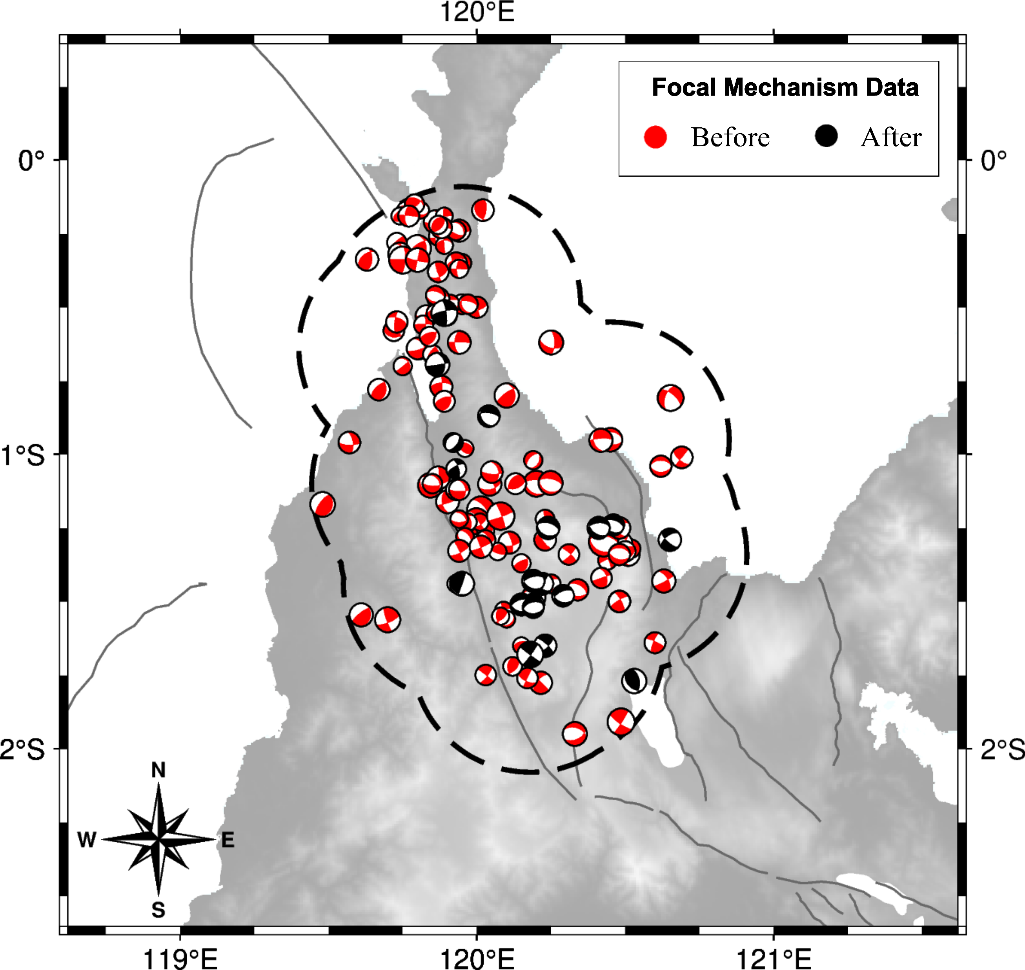
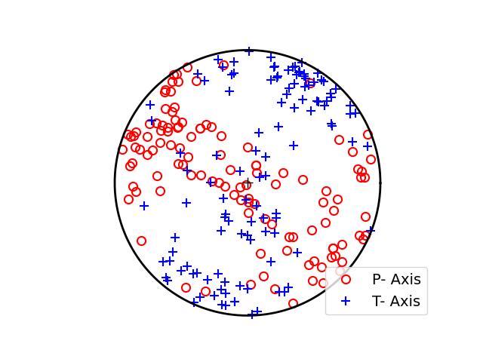
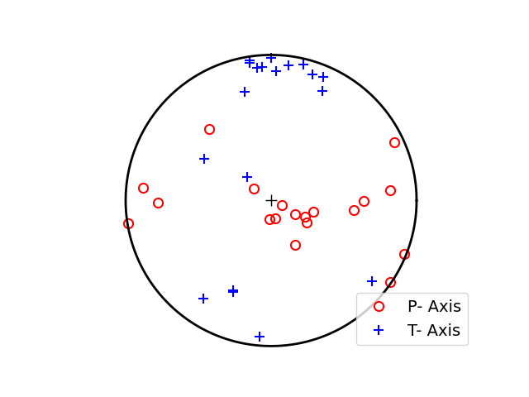
Focal Mechanisms Data
Before 2018 Mw7.5 Palu
118 events
May 1977 – Sep 2018
After 2018 Mw7.5 Palu
19 events
Sep 2018 – Nov 2021

Slide 3
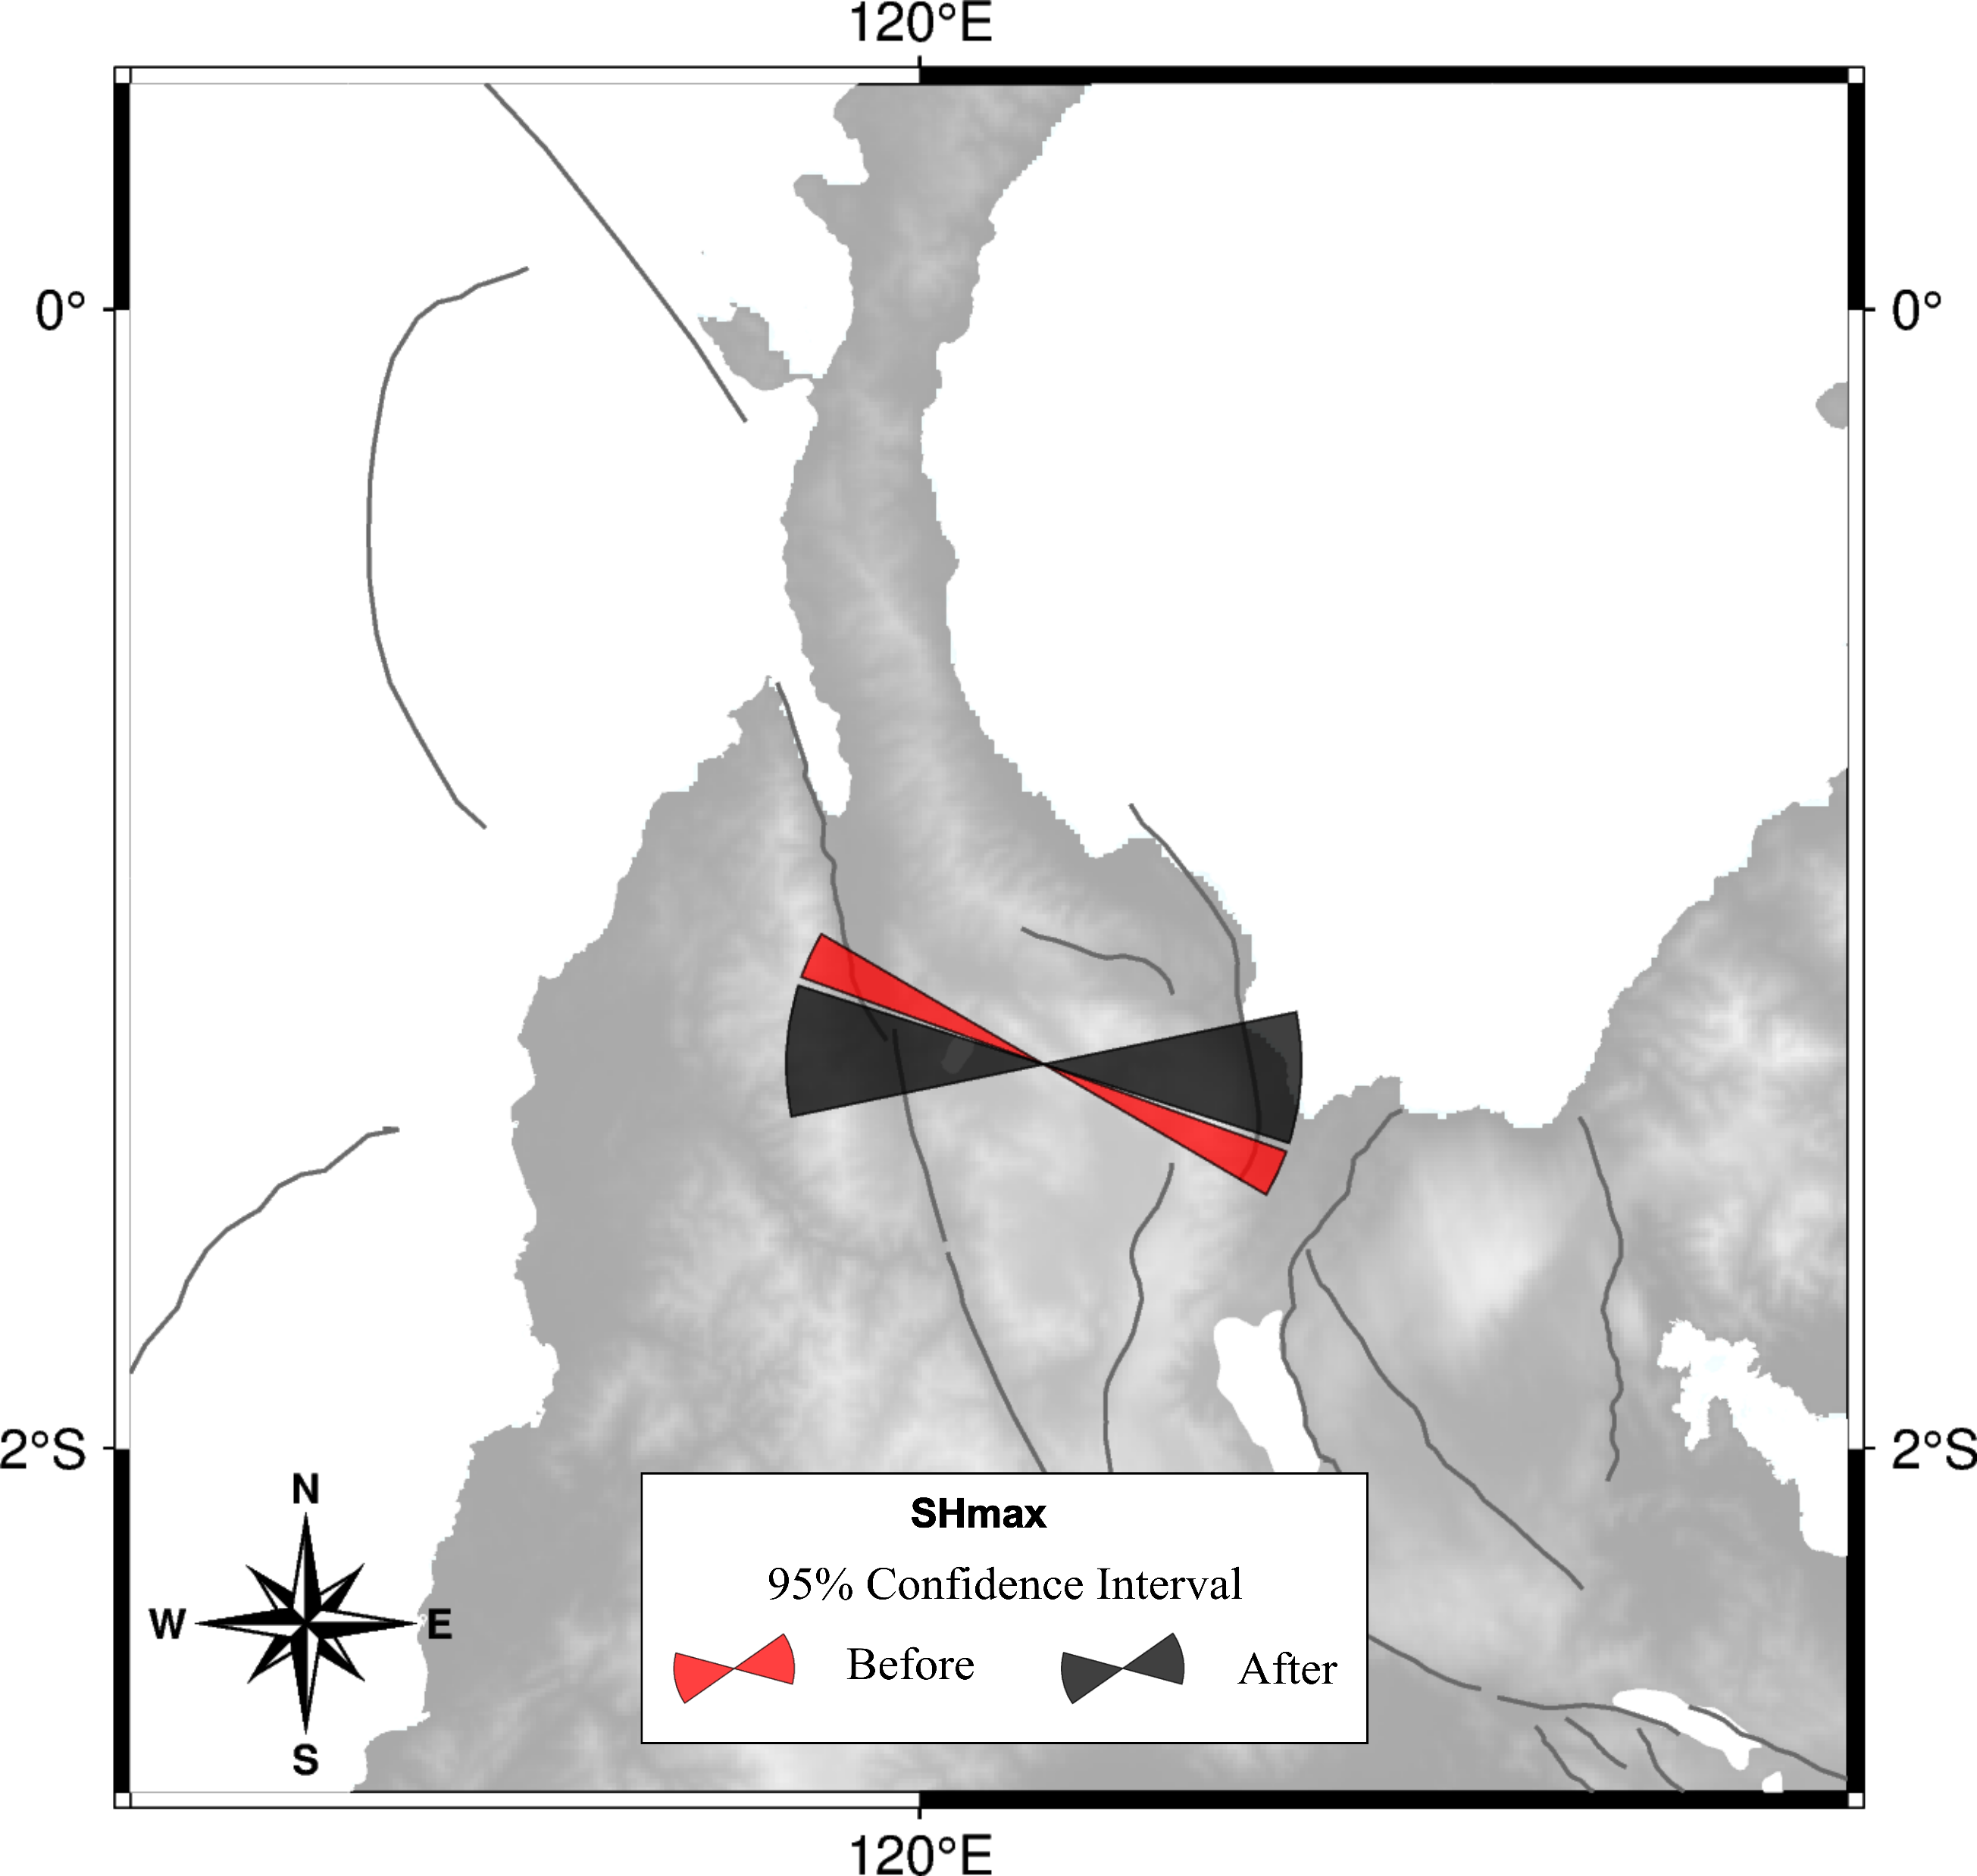
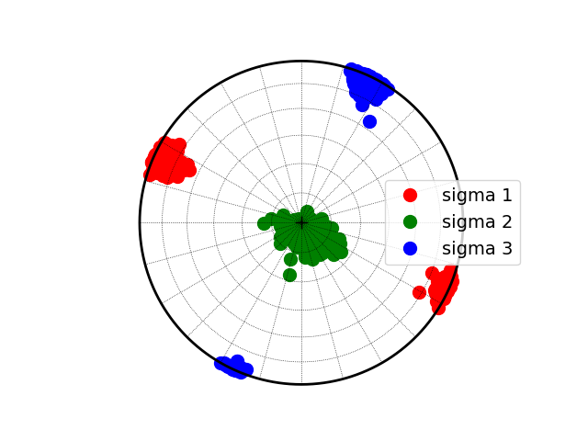
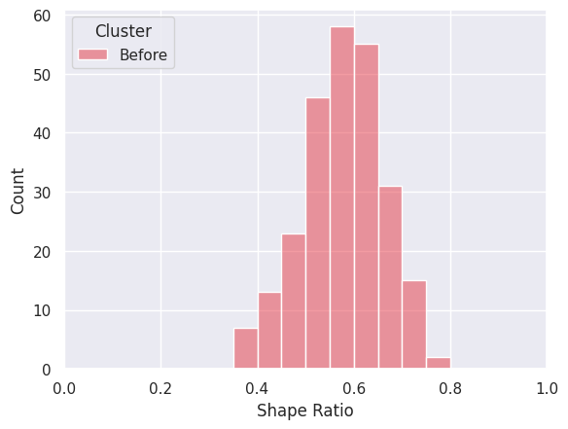
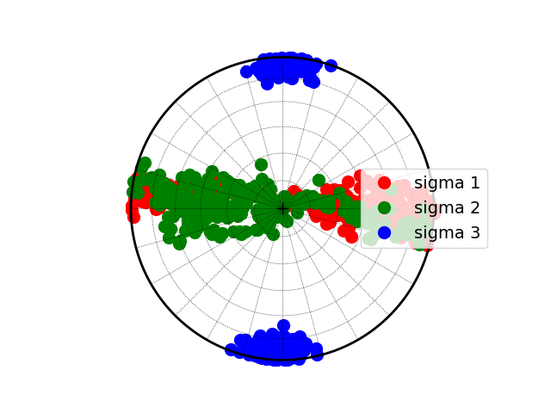
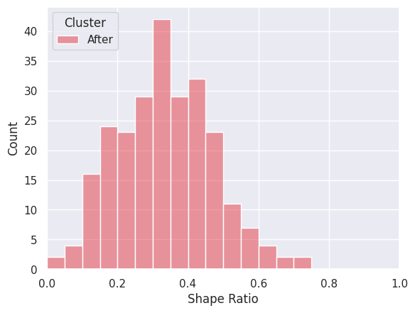
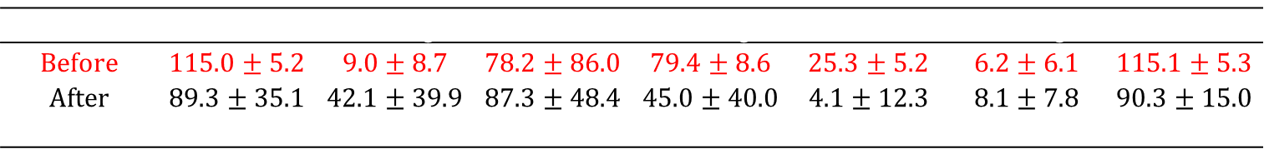
Stress Inversion Result
Before 2018 Mw7.5 Palu
After 2018 Mw7.5 Palu
 | $$σ1 Azimuth$$ | $$σ1 Plunge$$ | $$σ2 Azimuth$$ | $$σ2 Plunge$$ | $$σ3 Azimuth$$ | $$σ3 Plunge$$ | SHmax
Before | 115.0 ± 5.2 | 9.0 ± 8.7 | 78.2 ± 86.0 | 79.4 ± 8.6 | 25.3 ± 5.2 | 6.2 ± 6.1 | 115.1 ± 5.3
After | 89.3 ± 35.1 | 42.1 ± 39.9 | 87.3 ± 48.4 | 45.0 ± 40.0 | 4.1 ± 12.3 | 8.1 ± 7.8 | 90.3 ± 15.0
$$Δ$$ | -26.2 ± 33.9 | 35.3 ± 41.7 | 7.6 ± 106.3 | -35.9 ± 42.6 | -21.2 ± 13.4 | 0.5 ± 10.8 | -24.2 ± 15.3

Slide 4

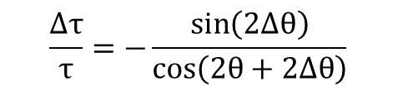
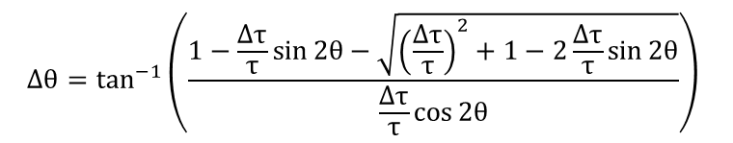
Stress Drop Ratio $\left(\frac{Δτ}{τ}\right)$ Calculation
To calculate the stress drop ratio, we use equation (4) in Hardebeck 2001
$$Δθ=\tan^{−1}\left(\frac{1−\frac{Δτ}{τ}\sin{2θ}−\sqrt{{\left(\frac{Δτ}{τ}\right)}^{2}+1−2\frac{Δτ}{τ}\sin{2θ}}}{\frac{Δτ}{τ}\cos{2θ}}\right)$$
$$\frac{Δτ}{τ}=−\frac{\sin\left(2Δθ\right)}{\cos\left(2θ+2Δθ\right)}$$

Slide 5
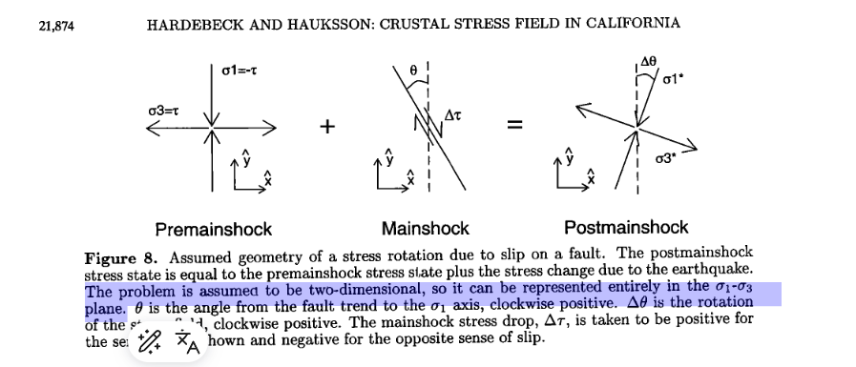
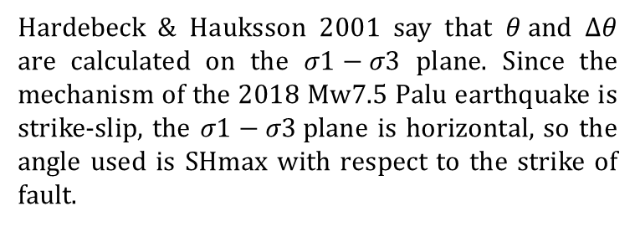

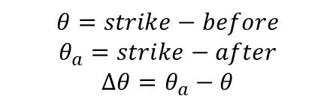

Calculation of $θ and Δθ$
Hardebeck & Hauksson 2001 say that $θ and Δθ$ are calculated on the $σ1−σ3$ plane. Since the mechanism of the 2018 Mw7.5 Palu earthquake is strike-slip, the $σ1−σ3$plane is horizontal, so the angle used is SHmax with respect to the strike of fault.
U
Nodal plane 2018 Mw 7.5 Palu
348$∙$57$∙$-15 87$∙$77$∙$-146
$$θ=strike−before$$
$$θ_{a}=strike−after$$
$$Δθ=θ_{a}−θ$$
$$Fault | Before | After | θ+Δθ | θ | Δθ$$
S

Slide 6
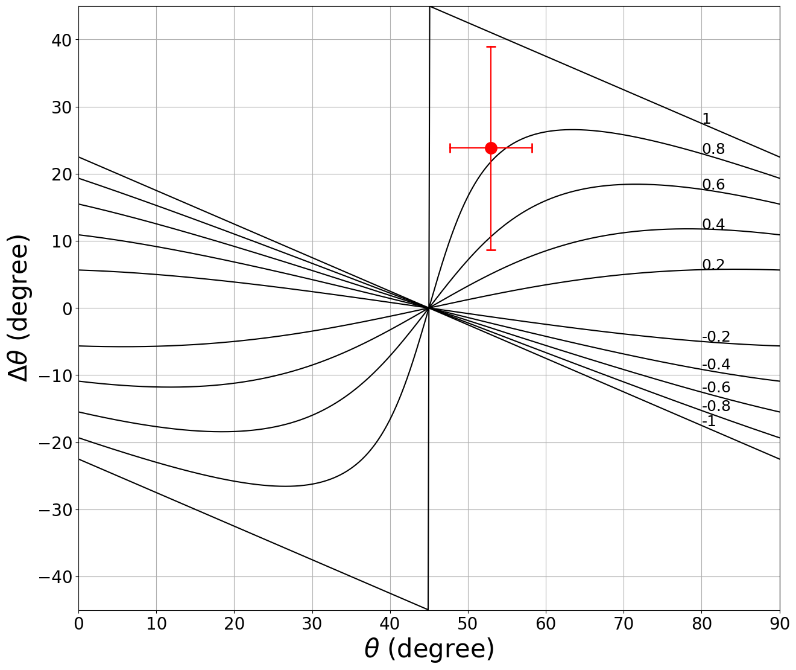
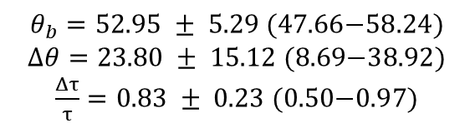
Model Stress Drop 2018 Mw 7.5 Palu by SHmax
$θ_{b}=\text{52.95 }±\text{ 5.29 (47.66−58.24)}$
$Δθ=\text{23.80 }±\text{ 15.12 (8.69−38.92)}$
$\frac{Δτ}{τ}=\text{0.83 }±\text{ 0.23 (0.50−0.97)}$

